Slide 1



The 1st International Conference on Sustainable Communication, Machine Intelligence and Metaverse (SCMIM-2025)
A Hybrid Fuzzy AHP-VIKOR Framework for Systematic Evaluation and Ranking of Metaverse Applications
Presented by
Sabarna Sarkar
Saptarshi Roychowdhury
Under the supervision of
Dr. Binod Kumar Singh
Associate professor, Dept. of CSE

Slide 2
Contents
Background Studies
Problem Statement
Methodology
Result
Conclusion
References
Introduction
Literature Survey

Slide 3
Introduction
The Essence of the Metaverse
The metaverse is a virtual, immersive, and interactive ecosystem that integrates augmented reality (AR), virtual reality (VR), and mixed reality (MR), enabling seamless interaction in a shared digital space.
A shared digital universe where users can live, work, socialize, and create, blurring the lines between physical and virtual realities. It represents the next evolution of the internet, enabling real-time, immersive experiences.
The metaverse is powered by advanced technologies like blockchain, artificial intelligence (AI), cloud computing, and 5G, ensuring seamless connectivity, data security, and immersive experiences.
The metaverse is set to become a trillion-dollar economy, driving innovation in industries like real estate, retail, gaming, and education through virtual assets, NFTs, and digital commerce.

Slide 4
Introduction contd.
Applications of the Metaverse
Healthcare and Telemedicine
Government and Public Services
Entertainment and Media
Corporate Workspaces
Legal and Judicial Systems
Humanitarian and Disaster Response
Defense and Military
Banking and Financial Services
Cultural Preservation and Heritage
Education and Training

Slide 5
Background Studies
Metaverse and Decision-Making: The metaverse is evolving as a transformative technology, but its widespread adoption requires robust evaluation frameworks to ensure alignment with societal, technological, and economic priorities.
Fuzzy Logic in Decision-Making: Fuzzy logic helps address uncertainties in subjective data by representing them as degrees of truth, making it highly suitable for complex technologies like the metaverse.
Hybrid MCDM Approaches:
Fuzzy AHP: Used to determine criteria weights by resolving ambiguities in expert judgments through pairwise comparisons.
Fuzzy VIKOR: Focuses on ranking alternatives by balancing group utility and individual regret to achieve compromise solutions.
Research Gap: Existing studies lack a comprehensive framework for addressing the unique challenges in evaluating metaverse applications. This study bridges the gap by combining Fuzzy AHP and Fuzzy VIKOR for systematic ranking.

Slide 6
Problem Statement
Challenge: Evaluating and prioritizing metaverse applications is a complex task due to the multidimensional nature of criteria such as scalability, inclusivity, innovation, and ethical considerations.
Key Issues:
Uncertainty in expert evaluations and subjective criteria.
Lack of a unified framework to address technological, societal, and regulatory impacts.
Conflicts between criteria, such as cost versus inclusivity or security versus user adoption.
Objective: To develop a structured, hybrid Fuzzy AHP-VIKOR framework that integrates criteria weighting and ranking, enabling systematic evaluation and decision-making for metaverse applications.

Slide 7
Literature Survey
Reference | Title of the Paper | Year | Journal Name | Main Findings
Mohamed et al. | Multi-criteria decision-making methodology for ranking and selecting optimal metaverse platform. | 2024 | Soft Computing Fusion with Applications | Ranking algorithm based on MCDM algorithms like TOPSIS, COPRAS, VIKOR for selecting optimal metaverse platform.
Abrar-ul-Haq et al. | Real Estate in the Metaverse | 2024 | Blockchain in Real Estate: Theoretical Advances and New Em- pirical Applications | The challenges and risk associated in application of metaverse in case of real estate.

Slide 8
Literature Survey contd.
Reference | Title of the Paper | Year | Journal Name | Main Findings
Nesaif et. al. | The Impact of Metaverse Business on the Real Estate Industry. | 2023 | International Journal for Innovative Research in Science & Technoology (IJIRST) | The study examines Metaverse’s impact on Dubai real estate, revealing its potential to enhance transactions through immersive experiences while highlighting challenges like privacy, security, and legal issues.
Sleem et al. | Neutrosophic CRITIC MCDM methodology for ranking factors and needs of customers in product’s target demo- graphic in virtual reality metaverse. | 2023 | Neutrosophic Systems with Applications | Use of MCDM algorithm such as CRITIC method to analyze the needs of customer in virtual reality products.

Slide 9
Literature Survey contd.
Reference | Title of the Paper | Year | Journal Name | Main Findings
Husin et al. | Evaluation of Metaverse Tools Based on Privacy Model Using Fuzzy MCDM Approach. | 2023 | International Multi-Disciplinary Conference-Integrated Sciences and Technologies | developed a privacy evaluation framework for metaverse tools using a Fuzzy MCDM approach to prioritize tools based on privacy-related criteria for industrial cyber physical system.
Yawised et al. | From traditional business shifted towards transformation: The emerging business opportunities and challenges in ‘Metaverse’ era | 2022 | The International and National Conference on Business Administration and Accountancy (INCBAA) | Advantages-disadvantages and implementation feasibility of metaverse application in corporate environments.

Slide 10
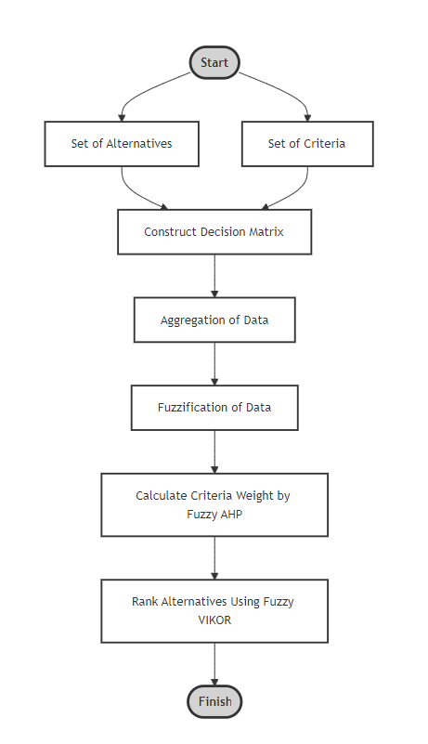
Methodology
Method used:
Fuzzy AHP (Criteria weight)
Fuzzy VIKOR (For Ranking Alternatives)
Fig 1: Ranking framework for Metaverse Application ranking using hybrid MCDM

Slide 11
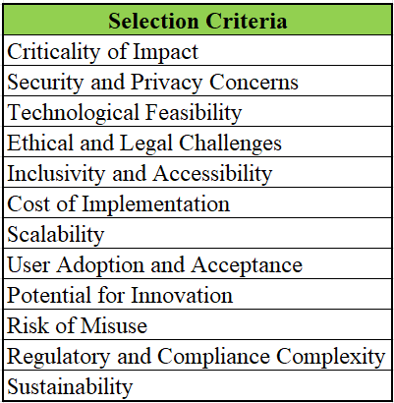
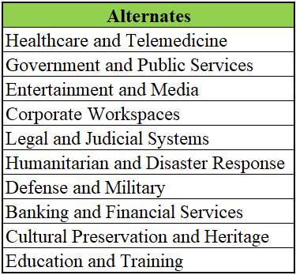
Methodology contd.
Criteria and Alternates

Slide 12
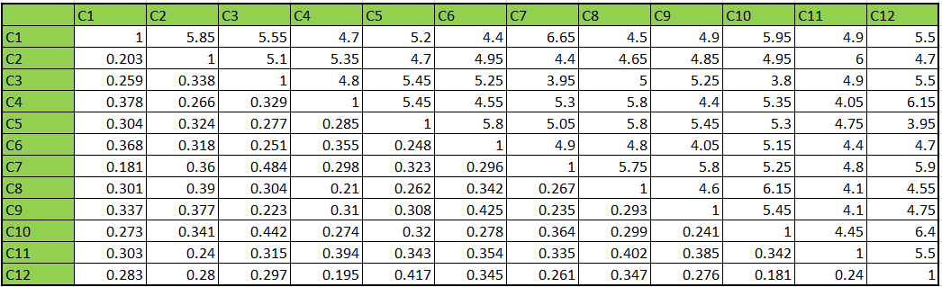
Result
Table 1: AHP Pairwise Comparison

Slide 13
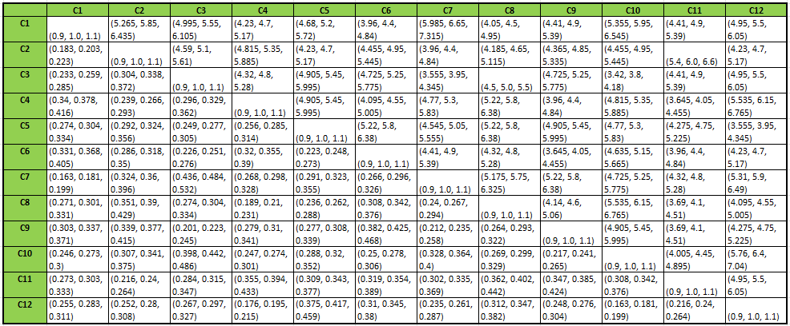
Result contd.
Table 2: Fuzzified AHP Pairwise Comparison

Slide 14
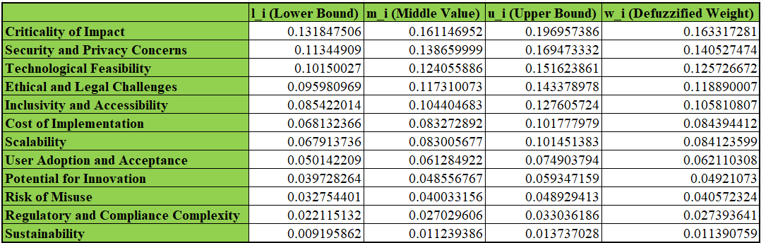
Result contd.
Table 3: Weight calculated by Fuzzy AHP

Slide 15
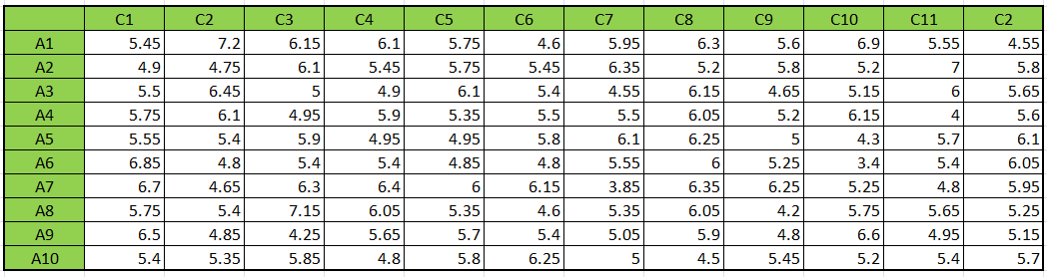
Result contd.
Table 4: VIKOR Decision Matrix

Slide 16
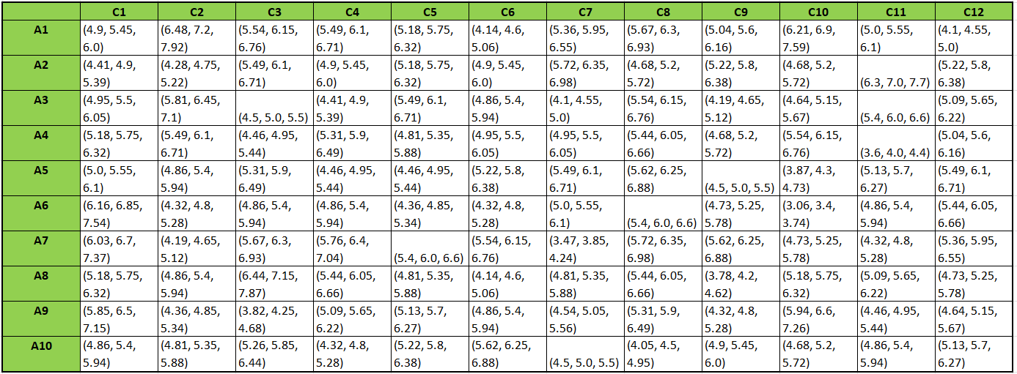
Result contd.
Table 5: Fuzzified VIKOR Decision Matrix

Slide 17
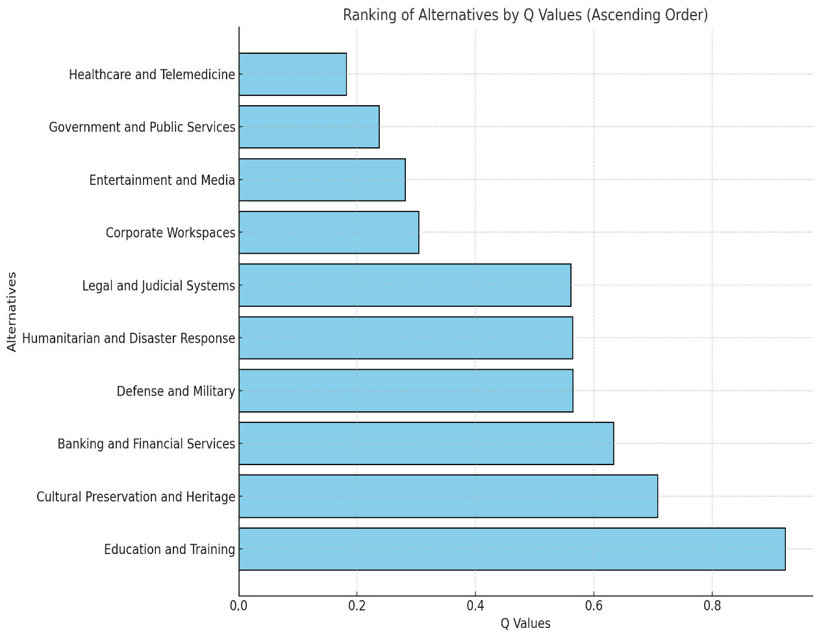
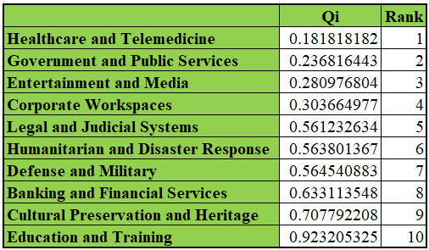
Result contd.
Table 6: Ranking by Fuzzy VIKOR
Fig. 2: Bar Chart Displaying the Alternatives Ranked

Slide 18
Conclusion
Comprehensive Framework: The study presents a hybrid Fuzzy AHP-VIKOR framework for evaluating and ranking metaverse applications, addressing uncertainties in criteria weightage and rankings.
High-Performing Applications: Applications like Healthcare and Telemedicine, as well as Government and Public Services, stand out due to strong performance in inclusivity, scalability, and societal impact.
Identified Challenges: Applications like Cultural Preservation and Heritage and Banking and Financial Services ranked lower due to limitations in scalability and technological feasibility.
Actionable Insights: The framework provides stakeholders with a systematic tool to make informed decisions, align investments with societal priorities, and optimize resource allocation in the metaverse ecosystem.
Future Scope: Emphasizes the need for further development in underperforming areas and refining the framework to include dynamic and emerging criteria for better adaptability.

Slide 19
References
Xiong, J., Hsiang, E.-L., He, Z., Zhan, T., & Wu, S.-T. Augmented reality and virtual reality displays: emerging technologies and future perspectives. Light: Science & Applications,10(1), 1–30, (2021).
Awasthi, A., Govindan, K., & Gold, S. Multi-tier sustainable global sup- plier selection using a fuzzy AHP-VIKOR based approach. International Journal of Production Economics, 195, 106–117, (2018).
Kreinovich, V., Kosheleva, O., & Shahbazova, S. N. Why triangular and trapezoid membership functions: A simple explanation. Recent Developments in Fuzzy Logic and Fuzzy Sets: Dedicated to Lotfi A. Zadeh, 25–31, (2020).
Isabels, R., Vinodhini, A. F., & Viswanathan, A. Evaluating and ranking metaverse platforms using intuitionistic trapezoidal fuzzy vikor MCDM: Incorporat- ing score and accuracy functions for comprehensive assessment. Decision Making: Applications in Management and Engineering, 7(1), 54–78, (2024).
Dagli, N. Advancement in telemedicine and teledentistry with virtual reality and metaverse. Journal of International Oral Health, Vol. 14, pp. 529–530. Medknow (2022).
Hawkins, M. Virtual employee training and skill development, work- place technologies, and deep learning computer vision algorithms in the immersive metaverse environment. Psychosociological Issues in Human Resource Management, 10(1), 106–120, (2022).
Tadić, S., Krstić, M., & Radovanović, L. Assessing strategies to overcome barriers for drone usage in last-mile logistics: a novel hybrid fuzzy MCDM model. Mathematics, 12(3), 367, (2024).

Slide 20
Thank You

